Slide 1
Mathematical Foundations for Data Science
MFDS Team

Slide 2
DSECL ZC416, MFDS
Lecture No. 7

Slide 3
Agenda
Reddy Mikks Problem
  Formulation and graphical method
  TORA
Urban Renewal Model
  Formulation and feasibility
Currency Arbitrage Model
  Formulation and applicability

Slide 4
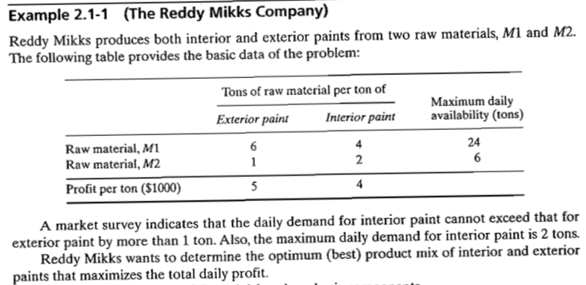
Problem 1: Reddy Mikks Company

Slide 5
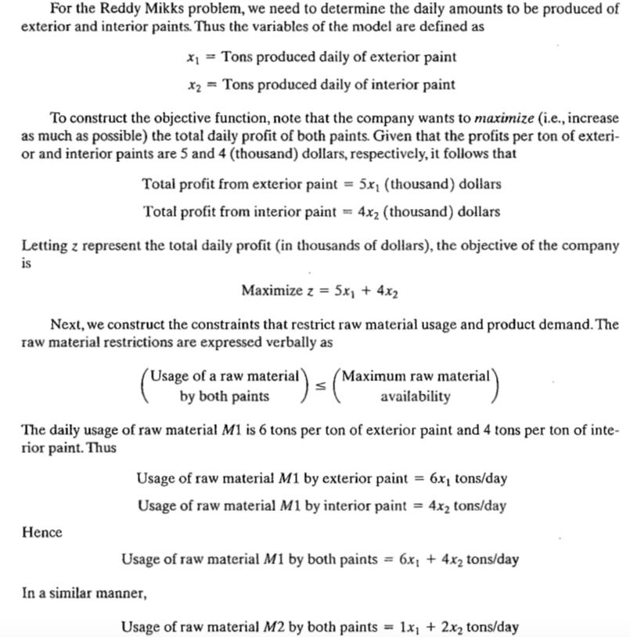

Slide 6
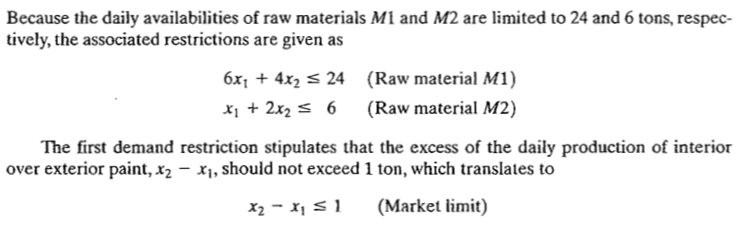
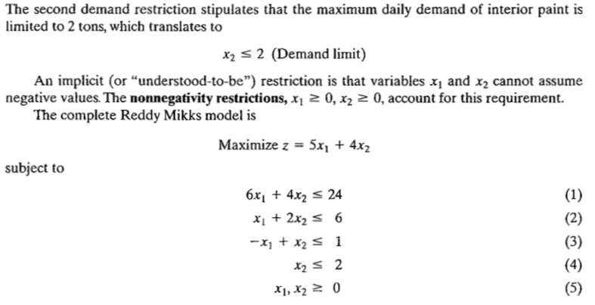

Slide 7
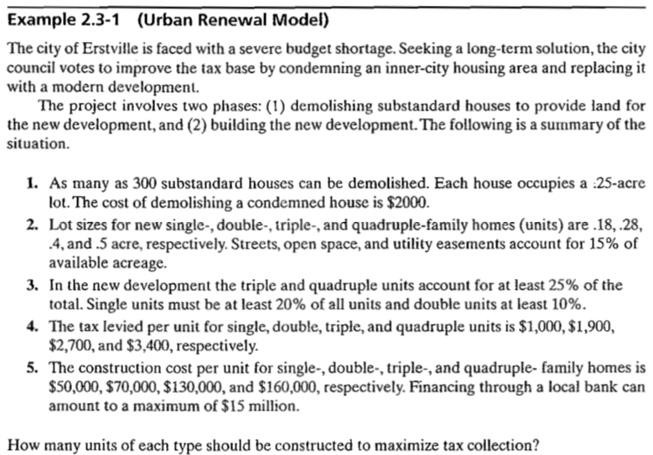
Problem 2: Urban Renewal Model

Slide 8
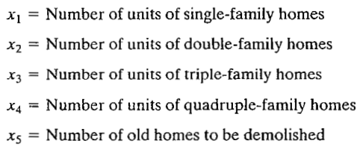

Problem 2: Urban Renewal Model
Step 1: Define Variables of the problem
Step 2: Define Objective that we need to optimize

Slide 9
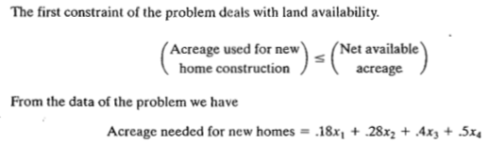
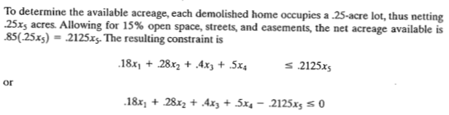
Problem 2: Urban Renewal Model

Slide 10
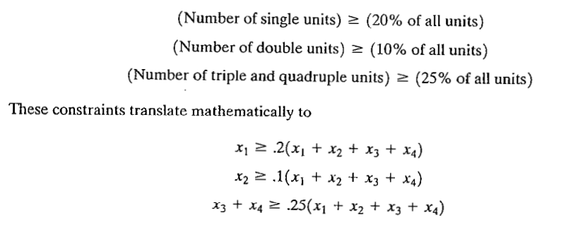
Problem 2: Urban Renewal Model

Slide 11
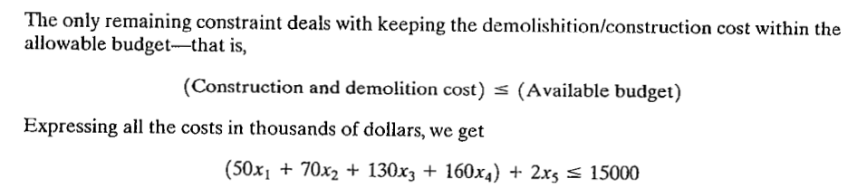
Problem 2: Urban Renewal Model

Slide 12
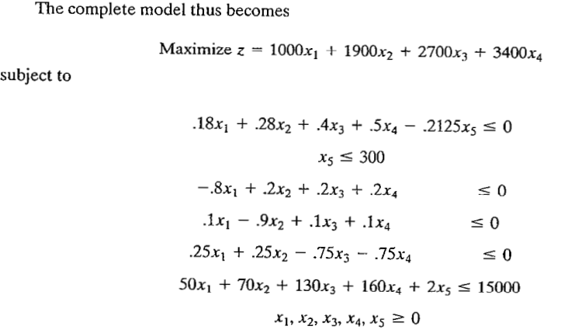
Problem 2: Urban Renewal Model

Slide 13
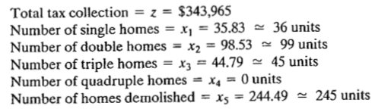
Problem 2: Urban Renewal Model
However, the feasible solution is
x₁ = 36, x₂ = 98, x₃ = 45, x₄ = 0 and x₅ = 245

Slide 14
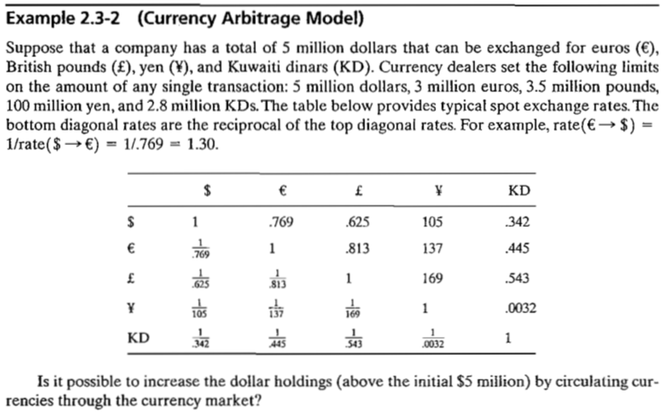
Problem 3: Currency Arbitrage Model

Slide 15
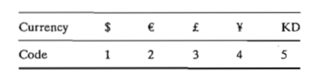
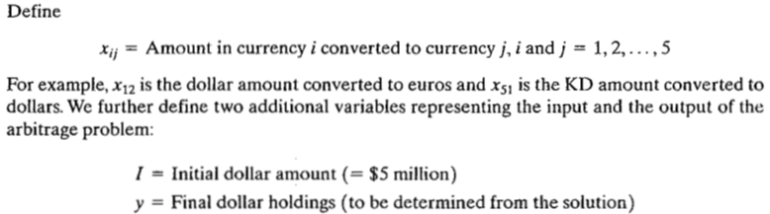
Problem 3: Currency Arbitrage Model

Slide 16
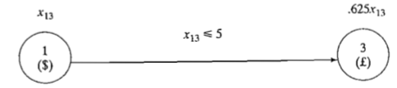
Problem 3: Currency Arbitrage Model
Transacted dollar amount cannot exceed the limit set by dealer x₁₃ ≤ 5

Slide 17
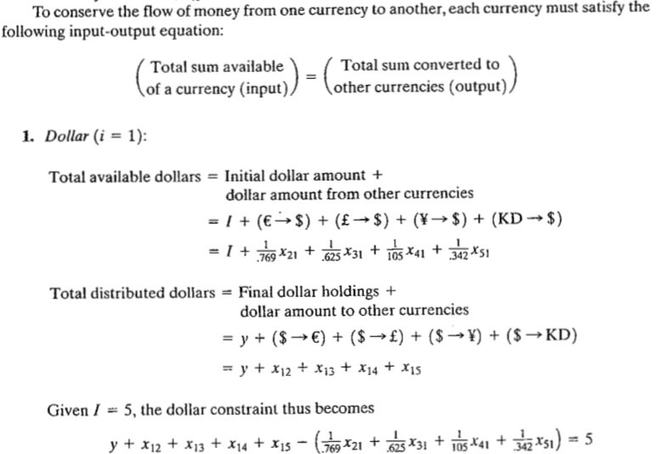

Slide 18
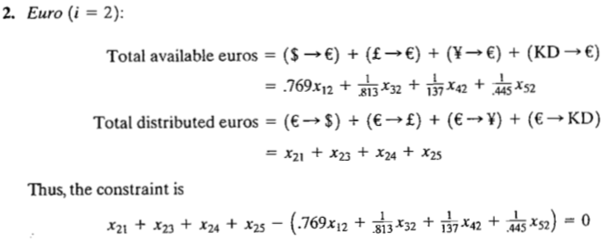

Slide 19
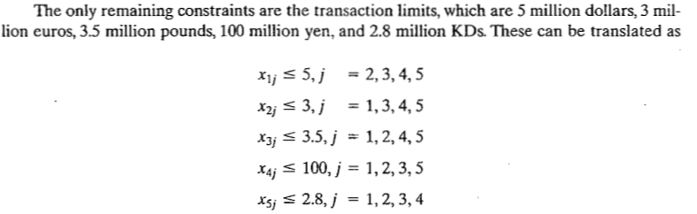
Transaction Limit

Slide 20
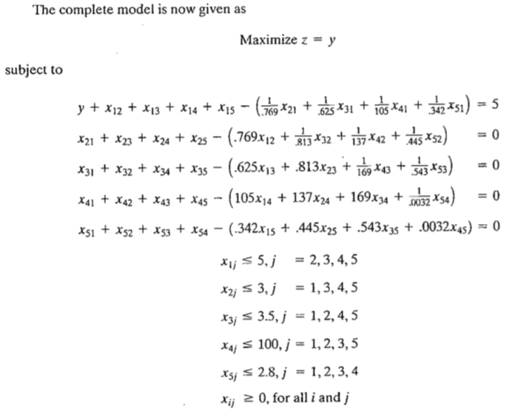
Problem 3: Currency Arbitrage Model

Slide 21
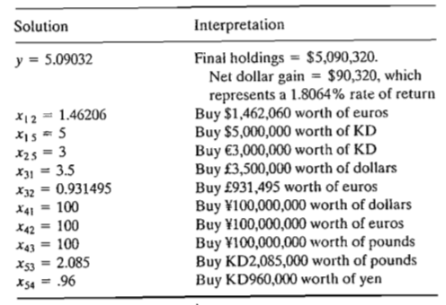
Problem 3: Currency Arbitrage Model

Slide 22

Problem 3: Currency Arbitrage Model
At first it may appear for solution to be nonsensical as it calls for using x₁₂ + x₁₅ = 1.46206 + 5 = 6.46206 = $6,462,060 to buy Euros or KD but initial dollar amount is only $5 million
In practice the given solution is submitted to the currency dealer as one order, we do not wait until we accumulate enough currency of certain type before making a buy.

